Slide 1
Sustainable Customized Logistics
Panelists:
Jack Pyros, Momentum Groups
Shawn Stockman, OnePak
Marc Ziade, Zoomo
Moderated by:
Patrick Scardilli, Key Software

Slide 2
Reasons to go green
Sustainability
Lower Op. Cost
Efficiency/Price Competitive
ESG Rating
Software/AI/Big Data
Positive Brand Impact
Higher Valuation

Slide 3
Barriers to going green
Independent Contractors
Ownership buy-in
Landlord buy-in
Upfront costs
EV Availability
Local Grid Readiness

Slide 4
If you don’t go green
Ride Share Competition (vehicles & drivers)
QSR / DYI
Retailer ESG Demand
Regulations ($/mi)
Unpredictable Fuel Costs
Negative Brand Impact

Slide 5
Rewards to going green
Renewable Energy
Reusable Packaging
Retailer ESG Demand
Vehicle 2 Grid
Local Grid Stability
Charging Rev Stream
Attract Drivers

Slide 6
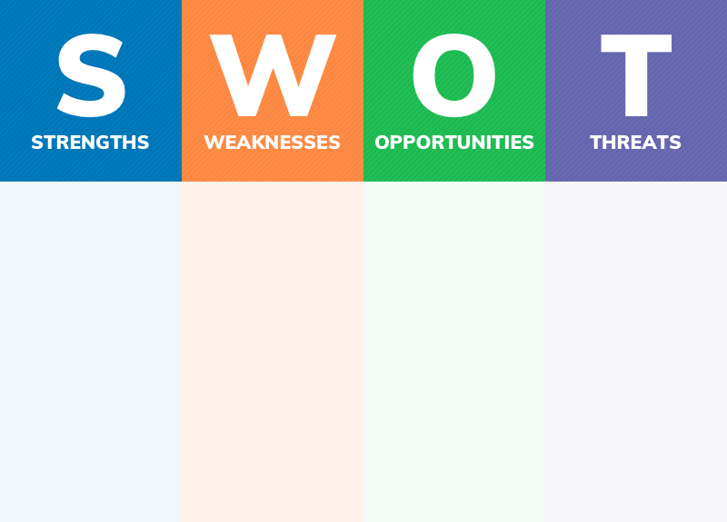
Q & A
(Reasons to go green)
(Barriers to going green)
(Rewards to going green)
(If you don’t go green)
Sustainability
Lower Op. Cost
Efficiency (cost/del)
ESG Rating
Software/AI
Independent Contractors
Ownership buy-in
Landlord buy-in
Upfront costs
EV Availability
Local Grid Readiness
Renewable Energy
Reusable Packaging
Retailer ESG Demand
Vehicle 2 Grid
Local Grid Stability
Charging Rev Stream
Attract Drivers
Ride Share Competition (vehicles & drivers)
QSR
Regulations ($/mi)
Unpredictable FSC

