Slide 1
Express Air Logistics
How to land the business
Notes:
Checked with Bill to send me white logo so it doesn't clash

Slide 2
Agenda
ABCs of IAC/Agent Relationship
Self-Managed Agent Program
CLDA Advocacy with TSA

Slide 3
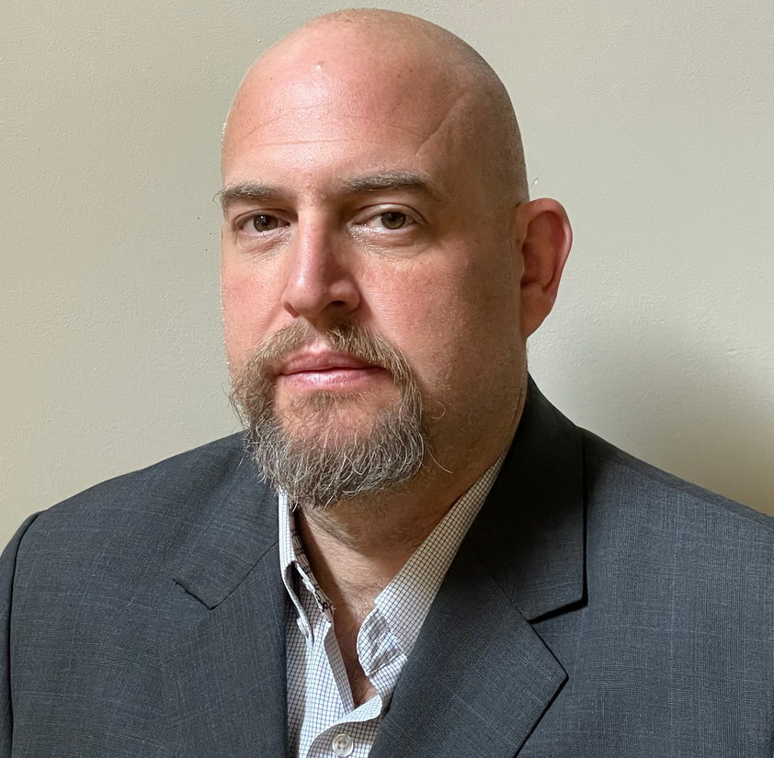
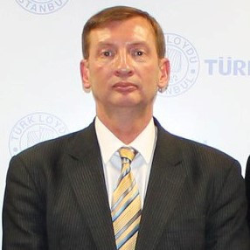
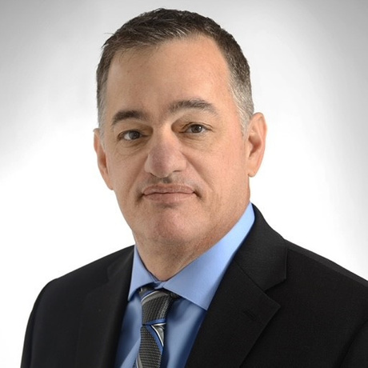
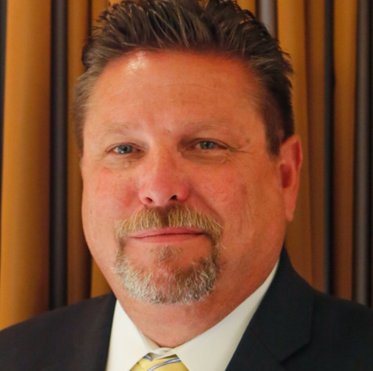
Panelist
Panelist
Panelist
Moderator
Greg Hanna,
MNX Global Logistics
Michael Taylor,
CLDA Director for Government Affairs
Ralph Perrothers,
On The Go Cargo
Charlie Wolfe,
Blaze Express Courier Service

Slide 4
ABCs of IAC/Agent Relationship
What is an IAC?
What are IACs looking for in an agent?
Services and capabilities

Slide 5
What are IACs looking for?
Compliance
STAs
TWIC
Authorized Agent Agreement

Slide 6
Self-Managed Agent (SMA) Program

Slide 7
Self-Managed Agent (SMA) Overview
The SMA is an authorized representative for any IACs that will manage their own STAs. They will have ownership of their own user’s accounts and all of their associated STAs:
Create, renew and pay STAs
Associate existing STAs to their IAC customers
Bulk upload, merge, and delete STAs
Provide additional users at their company with access to IACMS
Update and manage their company contact information
IAC profiles inherit updates you make to your profile in real time

Slide 8
How to participate in the SMA program
IAC sponsors the agent on IACMS website
Go to IACMS https://iac.tsa.dhs.gov/iac/
Agent sets up their profile on IACMS and receives Agent ID number
IAC adds agent to their profile
Assign one person within your company to be the initial company IACMS SMA coordinator
User guide will soon be posted on the CLDA Online Resource Center

Slide 9
SMA Advantages for Agents
For the agent:Manage your own TSA compliance directly
Apply for STAs under your own profile
Updates visible in real-time to IAC assigned
More IACs will be transitioning to SMAs or requiring agents to become SMAs
Download complete updated driver list to easily upload to Veroot

Slide 10
SMA Advantages for IAC/Forwarders
Adding as an SMA completely populates driver list with STAs in seconds
Decreases the effort for agent compliance by utilizing SMAs
Inherit updates live as SMA agents apply them within the IAC profile directly
No longer needs to apply for STAs for agents
Only needs to check for expiring STAs under SMA profile

Slide 11
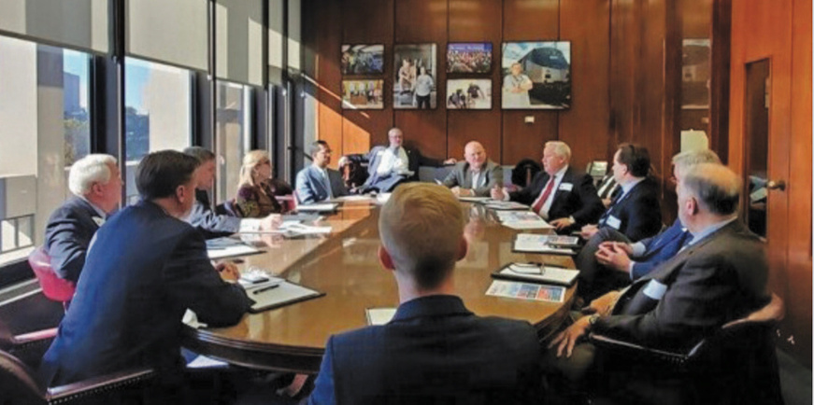
CLDA on TSA Advocacy
CLDA helping influence change working together with TSA on a roadmap for improvement
TSA recognizes CLDA membership as industry stake holders
Regular calls with TSA

Slide 12
Advocacy Initiatives and Results
Working with AFA and NCBFAA to ensure that IACs are not left in the dark as TSA forces changes to the air cargo industry while implementing ICAO 100% screening mandate.
Advocacy before TSA Air Cargo Division to provide compliance enforcement relief for IACs and on-demand charter operators during implementation period of new ICAO standard.
Advocacy for a policy revision to IACSSP to reduce grey areas and issues with compliance audits over ID check requirements.

Slide 13
Thank you!

