Slide 1
Learning from 2020 and Performing in 2021 It’s Not Your Parents Final Mile
Presented by: Jim Tompkins
Founder and Chairman, Tompkins International
CLDA
Las Vegas, NV
June, 2021

Slide 2
Disclaimer
All the information in this presentation is the result of Tompkins International’s research of public information. There is no information being presented today that comes from any proprietary source. Tompkins International does not discuss information about their clients unless that information has been published.

Slide 3
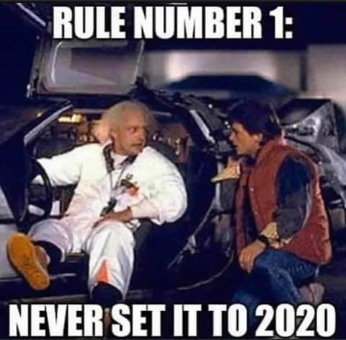

Slide 4
THE YEAR 2020: A DECADE OF
Disruptions
Tipping Points
Paradigm Shifts

Slide 5
DISRUPTIONS
VUCA – Volatility, Uncertainty, Complexity and Ambiguity
Black Swans
Highly improbable event
Unpredictable
Massive impact
After the fact we invent a story to make it appear less random

Slide 6
TIPPING POINT: THREE PHASES OF A CONCEPT
Introductory period;
A period of increasing popularity;
Building momentum until critical mass is achieved.

Slide 7
PARADIGM SHIFTS: DISCOVERING THE FUTURE
Good ideas are rejected because they assume the future will be like the past.
People resist change when they operate with old paradigms.
People who shift paradigms are often outsiders.

Slide 8
2021: IT’S NOT YOUR PARENT’S FINAL MILE
Disruptions have happened.
Tipping Points have been reached.
Paradigms have shifted.

Slide 9
WHAT DOES HOLIDAY 2021 AND THE FUTURE OF FINAL MILE LOOK LIKE?
What good ideas have been rejected?
Who resisted change?
Who were the outsiders?

Slide 10
WHAT GOOD FINAL MILE IDEAS HAVE BEEN REJECTED?
GOOD IDEAS
Distributed logistics.....
Competition.....
Speed.....
Customized.....
Adaptability, resilience and optionality.....
OBSOLETE PARADIGMS
Hub and spoke embraced
Oligopoly embraced
Business as usual embraced
Conformity to standard was embraced
Optimization of normal was embraced

Slide 11
WHO RESISTED FINAL MILE CHANGE?
Shippers
eCommerce will never be relevant.
Unichannel not relevant.
FedEx and UPS are the safe choices.
The fewer carriers we have the better.
Consumers
Gradual acceptance of eCommerce, COVID19 pushed folks to convenience.
I need to thump the cantaloupe.

Slide 12
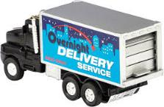
WHO WERE THE FINAL MILE OUTSIDERS?
Amazon
Walmart, Target and Home Depot
Regional Carriers
CLDA

Slide 13
FINAL MILE LESSONS LEARNED FOR HOLIDAY 2021 AND BEYOND
Become customer centric.
Be adaptable and resilient.
Embrace optionality, incomplete contracts and scalability.
Customize solutions for every supply chain.
Quality performance demands:
Modern technology
Professional drivers
Realistic expectations

Slide 14
IN CONCLUSION
It’s not your parent’s final mile.
Regional carriers who embrace the new paradigms will win and WIN BIG.
The disruptions of 2020 have accelerated history, tipping points have been reached and paradigms have shifted.
It is a new age for final mile.
WELCOME TO THE FUTURE: HOLIDAY 2021 IS THE NEW DAY.

Slide 15
Resources
Contact
Videos
James A. Tompkins, Ph.D.
Founder and Chairman, Tompkins International
6870 Perry Creek Road
Raleigh, NC 27616
(919) 637-2508
jtompkins@tompkinsinc.com
Asst: Debbie Flynn
Don’t Feed the Bears
https://www.tompkinsinc.com/en-us/Insight/Videos/dont-feed-the-bears
Anti-Brittle: Succeeding and Flourishing in These Uncertain and Volatile Times
https://www.tompkinsinc.com/en-us/Insight/Videos/anti-brittle-succeeding-and-flourishing-in-these-uncertain-and-volatile-times
Websites
www.tompkinsinc.com
www.tompkinsrobotics.com
Supply Chain Revolutions
Responding to Digital Disruptions
http://bit.do/supplychainrevolutions
IISE Webinar – 4.16.2020:
Business Continuity Strategies and Tactics in Periods of Major Disruption
https://www.iise.org/media/IISE/Business_Continuity_Strategies_and_Tactics_in_Periods_of_Major_Disruption.mp4

